Slide 1
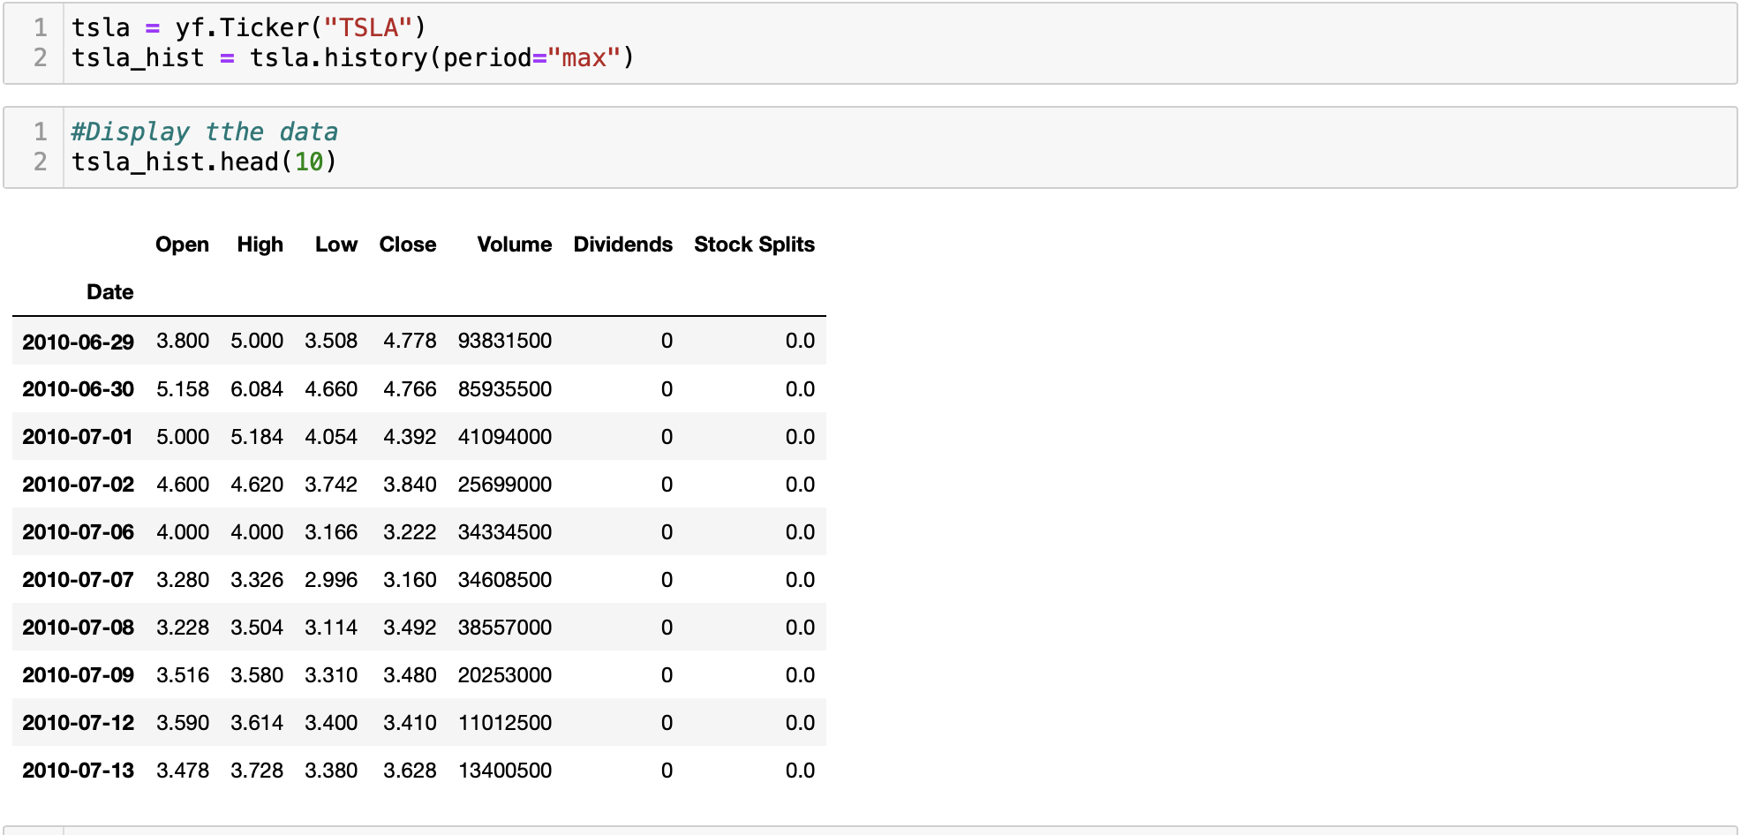
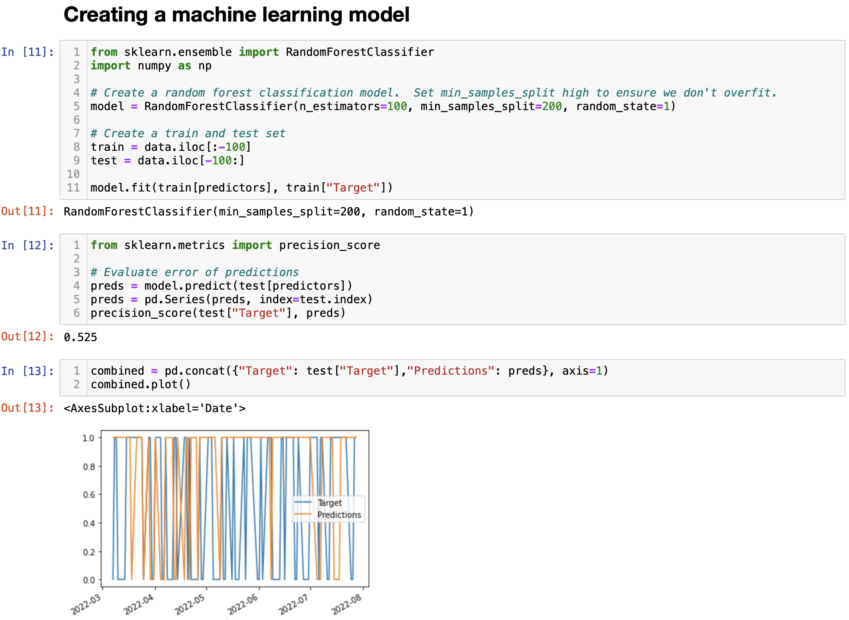
Model Analysis
Our model uses historical pricing and trading volume to predict future share prices for the top 10 electric vehicle companies and potential growth for Polestar.
Step 1 Pull pricing from Yahoo Finance API
Step 2 Predict future pricing for each EV stock

Slide 2
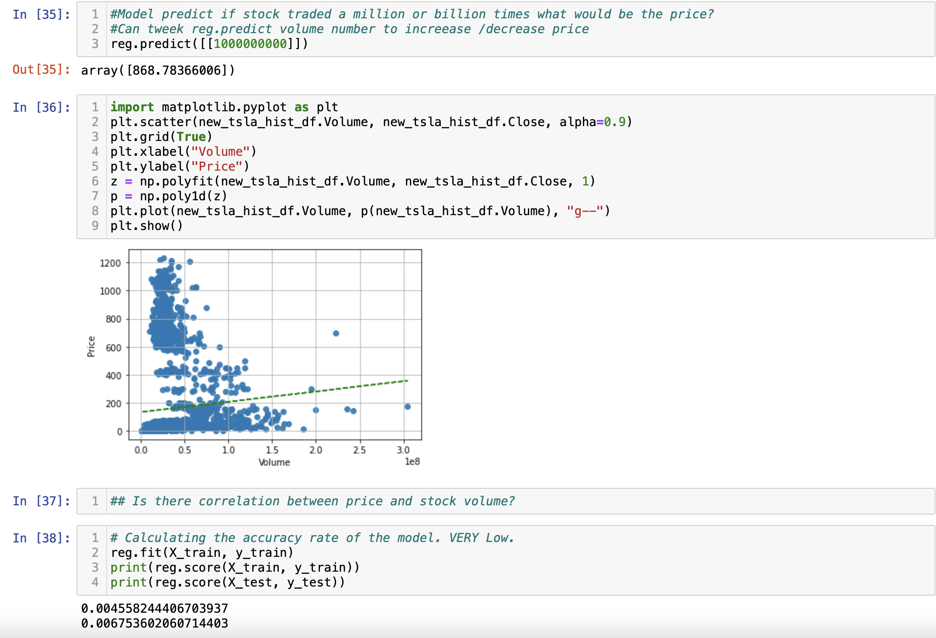
Model Analysis
Step 3 Predict future share price based on trading volume
* There is a correlation between price and volume but accuracy rate is very low.

